Slide 1
Passover
Notes:
A. WELCOME! Rom. 15:4 “For whatever things were written before were written for our learning, that we through the patience and comfort of the Scriptures might have hope.”
B. God commanded Israel to observe the Passover meal at sundown beginning the 14th of Nisan, the day before He brought them out of slavery in Egypt on the 15th.
For the following 7 days (Nisan 15th – 21st) called Unleavened Bread, He commanded them to eat only bread that was unleavened.
C. The New Testament explains and applies the hidden meanings for us which Israel is ignorant: READ 1 Cor. 10:1-12
The unblemished “Lamb” who must die for our freedom from sin was Jesus Christ.
The “Unleavened Bread” of Passover represents Jesus’ own separation from sin.
Eating only “Unleavened Bread” for seven more days represents our journey in becoming Christ-like, perfected.
The exodus from slavery represents our escape from sin because of Jesus’ sacrifice.
Crossing the red sea into the wilderness represents our baptism onto the difficult path that leads to Eternal Life.
The giving of the Law at Mt. Sinai represents Christ’s giving His New Law (Covenant) for us to obey (SoM-NT)
The water from the Rock & daily Manna represents God’s faithful provision as we walk the difficult wilderness path.
READ Cor. 5:6-8; 1 Cor. 11:23-32
D. Silent self-examination and confession of sin.
E. STAND for PRAYER & remain standing for 1st song.

Slide 2

The “Shema”
Deut. 6:4-9
Lyrics by MOSES
Music, arrangement, & recording by Diane Warner
Copyright © 4Winds Fellowships 2023

Slide 3
Hear, O Israel:
The LORD our God,
the LORD is one!

Slide 4
Hear, O Israel:
The LORD our God,
the LORD is one!

Slide 5
You shall love the LORD your God
With all your heart
With all your soul
And with all your strength

Slide 6
And these words which I command you today shall be in your heart
You shall teach them diligently to your children

Slide 7
And shall talk of them
When you sit in your house
When you walk by the way
When you lie down
And when you rise up

Slide 8
You shall bind them
as a sign on your hand
And they shall be as frontlets between your eyes

Slide 9
You shall write them on the doorposts of your house
And on your gates

Slide 10
Hear, O Israel:
The LORD our God,
the LORD is one!

Slide 11
Hear, O Israel:
The LORD our God,
the LORD is one!

Slide 12
You shall love the LORD your God
With all your heart
With all your soul
And with all your strength

Slide 13
And these words which I command you today shall be in your heart
You shall teach them diligently to your children

Slide 14
And shall talk of them
When you sit in your house
When you walk by the way
When you lie down
And when you rise up

Slide 15
You shall bind them
as a sign on your hand
And they shall be as frontlets between your eyes

Slide 16
You shall write them on the doorposts of your house
And on your gates

Slide 17
Hear, O Israel:
The LORD our God,
the LORD is one!

Slide 18
Hear, O Israel:
The LORD our God,
the LORD is one!

Slide 19
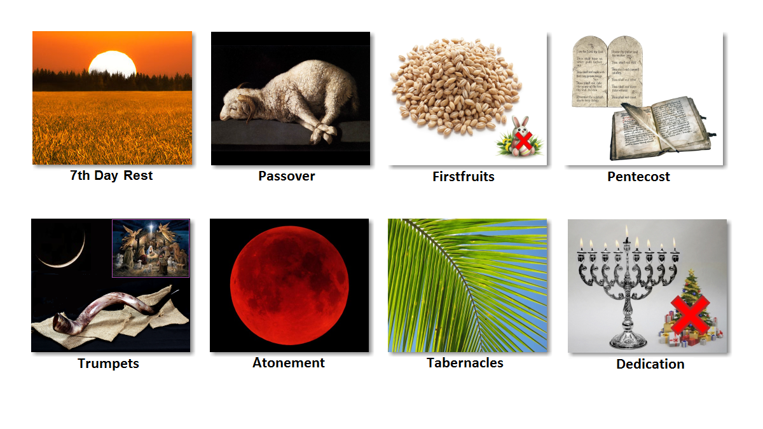
Festivals Jesus & His Disciples Observed
Notes:
1. The “Festivals of the LORD” are given in Lev. 23.
2. ALL OF THE FESTIVALS HAVE A THREE-FOLD MEANING: Past, Present, Future
3. All are ALLEGORIES pointing to Jesus’ role in the redemption of God’s creation.
4. Passover, First-fruits, and Pentecost were fulfilled on their exact corresponding calendar dates.
5. All of the Feasts will be celebrated in the Millennial KINGDOM except the “Day of Atonement” (Isa. 66:22-23; Ezek. 40-48; Jer. 3:14-18; Heb. 9)
6. Jesus was crucified on Passover day, He arose on First-fruits, He sent the Spirit upon the Apostles on Pentecost.
The Church of Rome eliminated some, and changed others, seeking to distance Christianity from Israel, destroying the parallels and blending pagan practices.
Stand to sing “The Table”

Slide 20

The Table
“The Table” words and music by Chris Tomlin, Ed Cash, Wayne Jolley
©2014 S. D. G. Publishing; Sixsteps Songs; Worship Together Music;
Alletrop Music;Terebinth Music
CCLI License #3244070

Slide 21
I will feast at the
Table of the Lord
I will feast at the
Table of the Lord

Slide 22
I won’t hunger anymore
At His table

Slide 23
I will feast at the
Table of the Lord
I will feast at the
Table of the Lord

Slide 24
I won’t hunger anymore
At His table

Slide 25
Come all you weary
Come and find
His yoke is easy
His burden light

Slide 26
He is able
He will restore
At the table of the Lord

Slide 27
There is peace at the
Table of the Lord
There is peace at the
Table of the Lord

Slide 28
I won’t worry anymore
At His table

Slide 29
There is healing at the
Table of the Lord
There is healing at the
Table of the Lord

Slide 30
I won’t suffer anymore
At His table

Slide 31
Come all you weary
Come and find
His yoke is easy
His burden light

Slide 32
He is able
He will restore
At the table of the Lord

Slide 33
I know He has a place for me
Oh, what joy will fill my heart
With the saints around
The mercy seat - of God
(Key change)

Slide 34
Come all you weary
Come and find
His yoke is easy
His burden light

Slide 35
He is able
He will restore
At the table of the Lord
At the table of the Lord
(Brief Interlude)

Slide 36
I’m invited to the
Table of the Lord
I’m invited to the
Table of the Lord

Slide 37
He says,
“Come just as you are”
To His table

Slide 38
Passover Preparations:
Lamb killed & roasted @ sunset
Blood applied to doorposts & lintel of house
All must remain inside the house until morning while the “Death Angel” killed Egypt’s firstborn

Slide 39
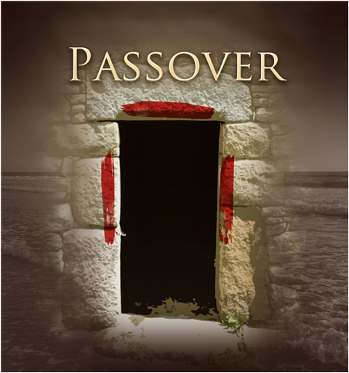
Opening Prayer
“Blessed are You Eternal GOD, Ruler of all Creation, who provided the Lamb Yourself, and were satisfied with His blood shed for the remission of our sins. May you motivate us through this Passover to ‘cleanse ourselves from all filthiness of the flesh and spirit, perfecting holiness in the fear of God,’ so that we may ‘walk worthy’ of our calling and His incomprehensible sacrifice, Amen.”
Notes:
STAND for COLLECTIVE OPENING PRAYER

Slide 40
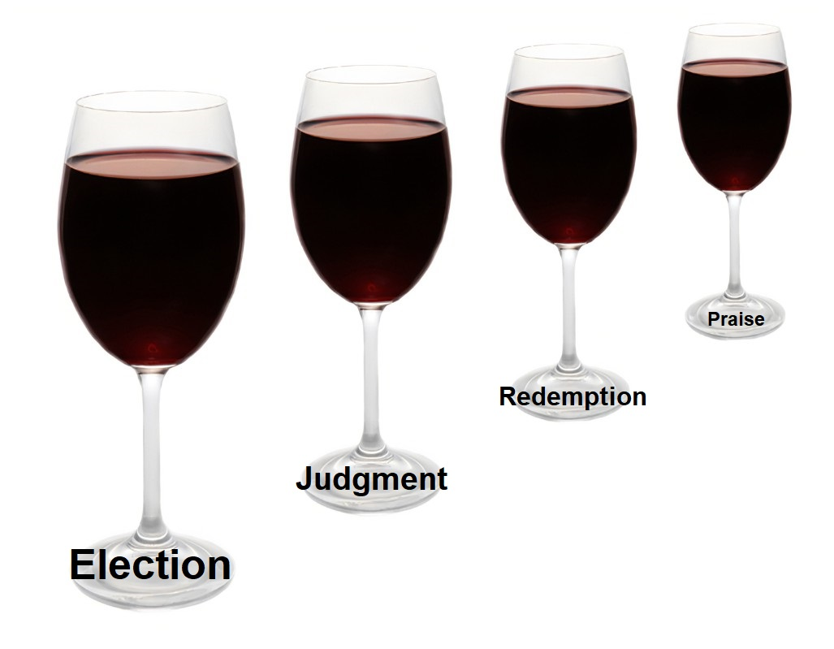
1
Notes:
The 4 Cups of wine:
Cup of ELECTION of a holy people Israel / Christians
Cup of JUDGMENT on Pharaoh / Satan & Antichrist
Pause for MEAL INTERLUDE
3. Cup of REDEMPTION by the blood of the Lamb
4. Cup of PRAISE for God’s final deliverance in Christ’s coming Kingdom.
From Exodus 6:6-7

Slide 41
Exodus 6:6-7
“Therefore say to the children of Israel: ‘I am the LORD;
ELECTION: “I will bring you out from under the burdens of the Egyptians”
JUDGEMENT: “I will rescue you from their bondage”
REDEMPTION: “I will redeem you with an outstretched arm and with great judgments”
PRAISE: “I will take you as My people, and I will be your God”

Slide 42
1st Cup ELECTION Prayer
“Blessed are You LORD GOD of Abraham, Isaac, and Jacob, King of all Creation. You have invited us to become a chosen generation, a royal priesthood, a holy nation, Your own special people, that we may proclaim the praises of Him who called us out of darkness into His marvelous light.’”
Notes:
Hold Up the 1sr Cup and Say the Blessing together.
Drink together.

Slide 43
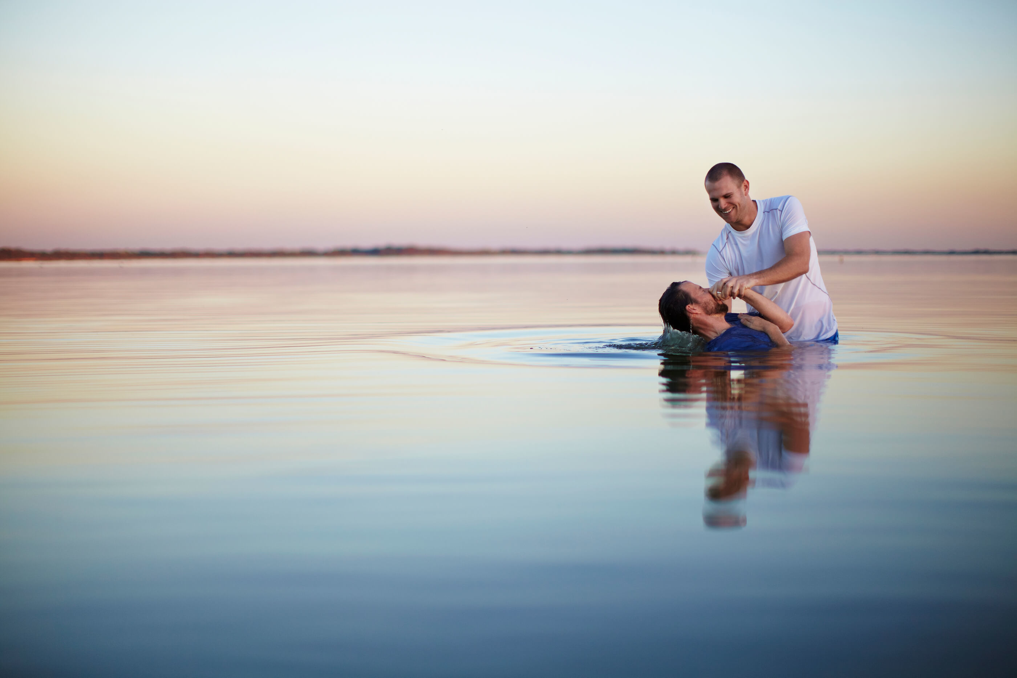
1 Corinthians 10:1-4
“Moreover, brethren, I do not want you to be unaware that all our fathers were under the cloud, all passed through the sea, all were baptized into Moses in the cloud and in the sea, all ate the same spiritual food, and all drank the same spiritual drink. For they drank of that spiritual Rock that followed them, and that Rock was Christ.
Notes:
Red Sea crossing = baptism (no turning back)
The LAW required the washing of hands before eating the Passover:
WASH HANDS TOGETHER – to remember our own baptism into Christ
(LARGE BOWN OF WATER)

Slide 44
Our Father
“Our Father” words and music by Robin Mark
©2014 Hillsong Music Publishing
CCLI License #3244070

Slide 45
The words of Christ
Passed down
Through generations
The Son of God
Teaching us to pray

Slide 46
Echoed words
Father, have Your will
Your way in me
Completely

Slide 47
We wholly trust
You’re faithful in provision
Amazing grace
Mercy for our sins

Slide 48
May we forgive
The way that
You’ve forgiven us
Oh Lord, so we can sing

Slide 49
Our Father
Hallowed be Your Name
Forever our God be exalted

Slide 50
Your Kingdom come
And [on earth]
Let Your will be done
Our Father

Slide 51
Lead us from
The valley of temptation
Deliver us from the evil one

Slide 52
Lord, You reign
And here we stand
Victorious in Your Name
Together we pray

Slide 53
Our Father
Hallowed be Your Name
Forever our God be exalted

Slide 54
Your Kingdom come
And [on earth]
Let Your will be done
Our Father

Slide 55
Yours is the Kingdom
And power and glory
God of authority
Ancient of Days

Slide 56
Yours is the wisdom
And honor
Forever and always
And always

Slide 57
Yours is the Kingdom
And power and glory
God of authority
Ancient of Days

Slide 58
Yours is the wisdom
And honor
Forever and always
We pray

Slide 59
Our Father
Hallowed be Your Name
Forever our God be exalted

Slide 60
Your Kingdom come
And [on earth]
Let Your will be done
Our Father

Slide 61
Our Father
Hallowed be Your Name
Forever our God be exalted

Slide 62
Your Kingdom come
And [on earth]
Let Your will be done
Our Father

Slide 63
We pray, our Father
We pray, our Father

Slide 64
Exodus 12:22-23
“And you shall take a bunch of hyssop, dip it in the blood that is in the basin, and strike the lintel and the two doorposts with the blood that is in the basin. And none of you shall go out of the door of his house until morning. For the LORD will pass through to strike the Egyptians; and when He sees the blood on the lintel and on the two doorposts, the LORD will PASS OVER the door and not allow the destroyer to come into your houses to strike you.”
Notes:
Read Scripture
12:00 POSITION
HISSOP (Parsley) dip in salt water (tears of slavery)
DIP & EAT TOGETHER

Slide 65
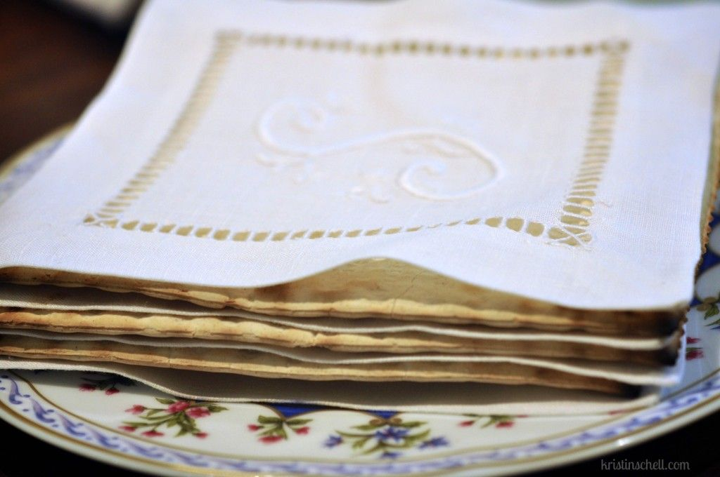
Breaking the Middle Matzah
“But we see Jesus, crowned with glory and honor, having been made a little bit lower than the messengers for the suffering of death, so that by the grace of God He might partake of death for every man. … For this cause He was obliged to become like His brothers in every way … (Heb. 2:9,17 LGV)
Notes:
READ TOGETHER
The UNLEAVENED BREAD (Matzah) represents a HOLY PEOPLE separated from the world to God.
The MIDDLE Matzah represents Jesus, fully man, of the holy seed of Abraham.
During the Passover, Jesus identified the MIDDLE Matzah with His flesh body, “this is My body.”
Jewish Passover tradition is to BREAK the MIDDLE Matzah in half, & have a child hide it.
HIDDEN ½ demonstrates that Jesus’ real identity was hidden from Israel’s religious leaders because of their hardened hearts, blinded eyes, and stopped ears
REMAINING ½ shows Jesus was not hidden from His disciples and Christians (the true “Holy” and “Separated” people).

Slide 66
2
Notes:
2nd CUP – JUDGEMENT upon EGYPT (Judgment upon the world and Satan)
2 days before Passover, Satan entered Judas Iscariot who was among the 12 present at the Passover.
After supper, Judas went out and gathered the temple guards and betrayed Jesus with a kiss.
Satan was seated at the Last Supper indwelling Judas.
Jesus declared in John 12:31-32 “Now is the judgment of this world; now will the ruler of this world be cast out. And I, when I am lifted up from the earth, will draw all people to myself.“
Do not drink yet!

Slide 67
1. Blood
2. Frogs
3. Vermin
4. Flies
5. Cattle Disease
6. Boils
7. Fiery Hail
8. Locusts
9. Darkness
10. Death
Notes:
Have girls recite the 10 plagues, as we dip finger in 2nd cup each time and taste.
Drink cup together to celebrate the overthrow of Pharaoh’s Kingdom, and Satan’s Kingdom of Darkness
The spiritual fulfillment parallels the plagues in Revelation upon the ungodly.

Slide 68
Exodus 1:13-14
“And the Egyptians made the Children of Israel to serve with rigor. And they made their lives bitter with hard bondage, in mortar, and in brick, and in all manner of service in the field; all their service, wherein they made them serve, was with rigor.”
Notes:
3:00 position on the Seder plate:
For Israel the bitter herbs represent the slavery to Pharaoh.
Recite verse together.

Slide 69
Titus 3:3-7 (LGV)
“For we also used to be foolish, stubborn, being deceived, being slaves to various desires and lusts, living in malice and envy, hateful, and hating one another. But when the kindness and benevolence of God our savior appeared, not from deeds of justice which we did, but according to His mercy He rescued us through the bath of rebirth and renewal of the holy Breath which He poured out upon us richly through Jesus Christ our savior, so that having been justified in His grace, we may become inheritors according to the hope of permanent life.”
Notes:
For us, the bitter herbs represent our former slavery to sin
Read together:
EAT BITTER HERBS

Slide 70
Prayer
“Blessed are You, O LORD our GOD, King of all Creation, the One enabling us for the portion of the inheritance of the holy ones in the light. You rescued us out of the authority of the darkness and transferred us into the Kingdom of the Son of Your love, in whom we have the release through His blood – the pardon of sins.” (Col. 1:13-14)
Notes:
STAND & Pray together.

Slide 71
Behold the Lamb of God (Isa. 53)
The Father’s Promised “GIFT”
“God Himself will provide the Lamb” (Gen. 22:8)
Notes:
John 1:29-30 (NASB) 29 The next day he saw Jesus coming to him, and said, "Behold, the Lamb of God who takes away the sin of the world!
30 "This is He on behalf of whom I said, 'After me comes a Man who has a higher rank than I, for He existed before me.‘
6:00 POSITION Lamb – Looked forward to the Father’s Promise of His “gift” – sending His only-begotten Son into the world to become human flesh and blood (John 3:16).
EAT Lamb
9:00 POSITION Sweet Charoset – God saw Israel’s suffering and sent a deliverer – Moses – to show them the way out of slavery.
God sent His Son into the world as the “Light of the world,” to show us the way to eternal life.
EAT Sweet Charoset

Slide 72
“Love Feast”
1 Cor. 11:21-34 & Jude 1:12
Notes:
Give thanks for the Meal

Slide 73
The Son’s Gift to the World
John 6:51 “I am the living bread which came down from heaven. If anyone eats of this bread, he will live forever; and the bread that I shall give is My flesh, which I shall give for the life of the world.”
Luke 22:19 “And He took bread, gave thanks and broke it, and gave it to them, saying, "This is My body which is given for you; do this in remembrance of Me.”
Notes:
HOLD UP the MIDDLE MATZAH half
Read Scriptures
GIVE THANKS FOR THE BREAD
BREAK MIDDLE MATZAH & PASS TO ALL
EAT TOGETHER

Slide 74
3
Notes:
Everyone HOLD UP 3rd CUP (Do not drink)

Slide 75
Matt. 26:27-29 “Then He took the cup, and gave thanks, and gave it to them, saying, “Drink from it, all of you. For this is My blood of the new covenant, which is shed for many for the remission of sins. But I say to you, I will not drink of this fruit of the vine from now on until that day when I drink it new with you in My Father’s Kingdom.”
Notes:
Read Scripture
Give thanks for the cup
Drink together
Stand for song

Slide 76
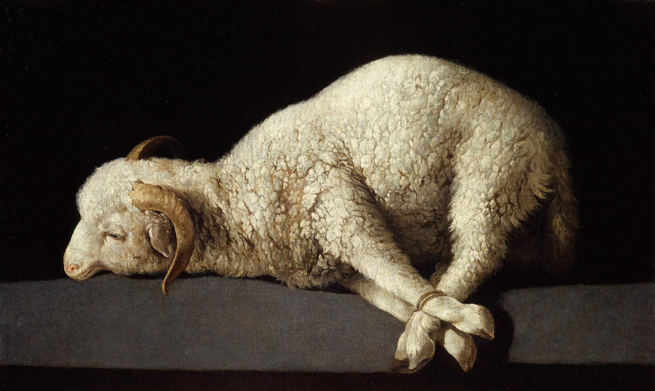
Behold the Lamb
By Kristyn & Keith Getty, Stuart Townsend
CCLI License #3244070

Slide 77
Behold the Lamb
Who bears our sins away
Slain for us - and we remember
The promise made that
All who come in faith
Find forgiveness at the cross

Slide 78
So we share in this bread of life
And we drink of His sacrifice
As a sign of our bonds of peace
Around the table of the King

Slide 79
The body of our Savior Jesus Christ
Torn for you - eat and remember
The wounds that heal
The death that brings us life
Paid the price to make us one

Slide 80
So we share in this bread of life
And we drink of His sacrifice
As a sign of our bonds of love
Around the table of the King

Slide 81
The blood that cleanses
Every stain of sin
Shed for you - drink and remember
He drained death's cup
That all may enter in
To receive the life of God

Slide 82
So we share in this love of life
And we drink of His sacrifice
As a sign of our bonds of grace
Around the table of the King

Slide 84
And so with thankfulness
And faith we rise
To respond, and to remember
Our call to follow in the steps of Christ
As His body here on earth

Slide 85
As we share in His suffering
We proclaim Christ will come again
And we’ll join in the Feast again
Around the table of the King
Around the table of the King

Slide 86
Luke 22:28-30 LGV
“But you are those who have continued with Me in My trials. And I am covenanting the Kingdom with you, just as My Father has covenanted with Me, so that you may eat and drink at My table in My Kingdom, and sit on thrones judging the twelve tribes of Israel.”
Notes:
Immediately after the third Cup of Redemption, Judas went out to betray Jesus.
Then Jesus said the following to His disciples: (Read together)

Slide 87
Hebrews 9:27-28 (LGV)
And accordingly as much as it is reserved to man once to die and judgment afterward, likewise the Anointed One also having been offered once, to carry the sins of the many, shall be seen a second time by those awaiting Him, separated from sin, for the deliverance.

Slide 88
4
Notes:
RETRIEVE the HIDDEN MATZAH. Symbolizing Jesus open reappearance to Israel and the world.
In the Gospels, the Passover ended with a HYMN
STAND: RAISE and hold up the 4th cup & sing

Slide 89
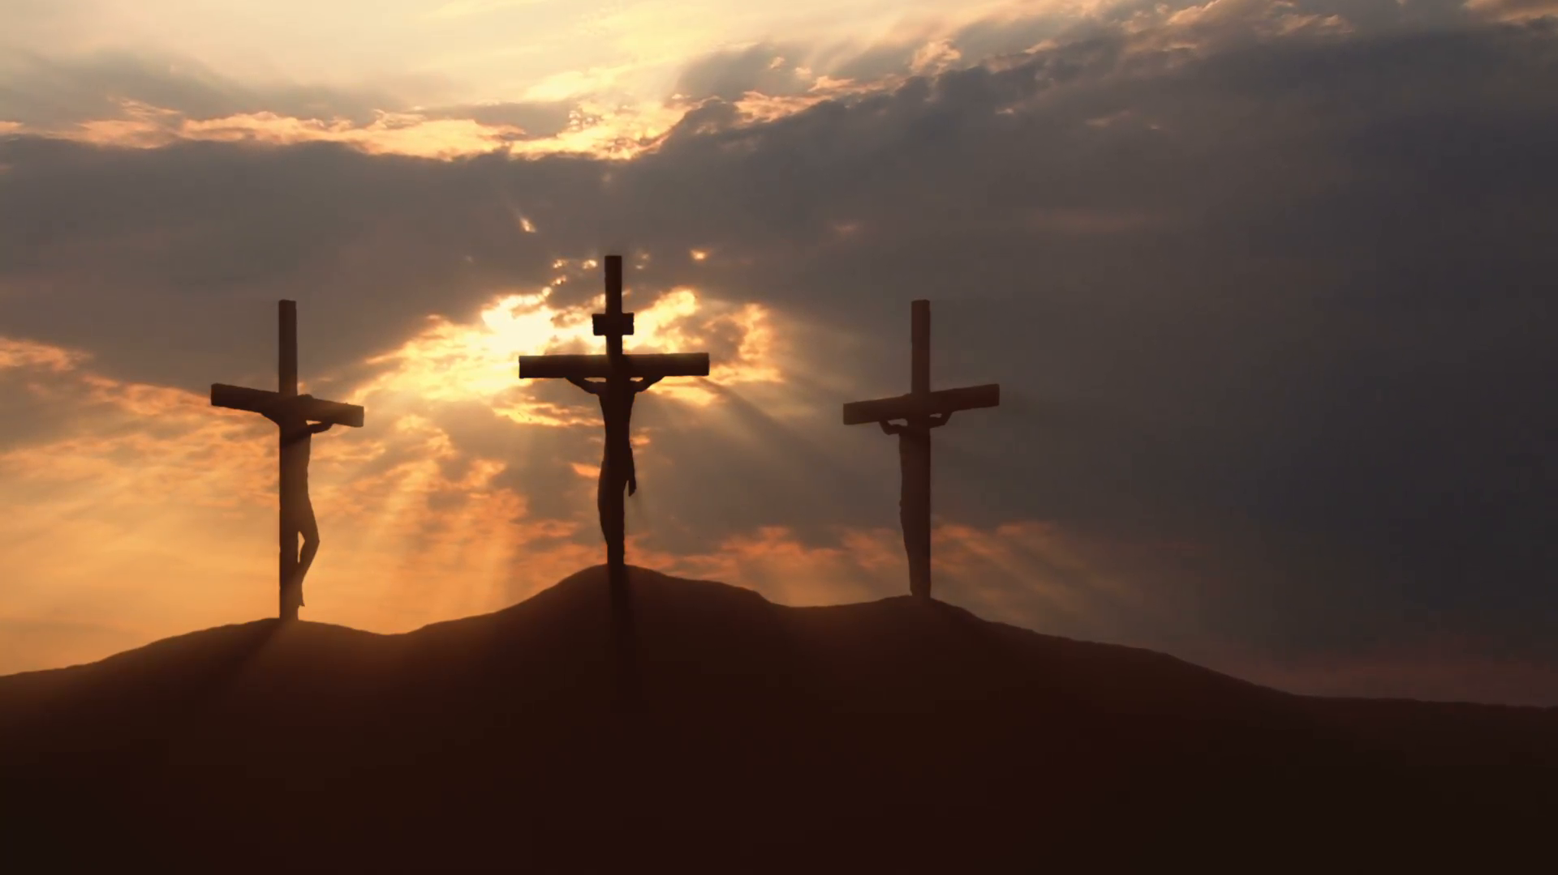

Behold the Lamb of God

Slide 90
We who walk in darkness deep
Now see the light of morning
The mighty God, the Prince of Peace
A child to us is born

Slide 91
Behold the Lamb of God
Who takes away our sin
Behold the lamb of God
The Life and Light of man

Slide 92
Behold the Lamb of God
Who died and rose again
Behold the Lamb of God
Who comes to take away our sin

Slide 93
Wanderers in the wilderness
O hear a voice is crying
Prepare the way
Make straight the path
Your King has come to die

Slide 94
Behold the Lamb of God
Who takes away our sin
Behold the Lamb of God
The Life and Light of man

Slide 95
Behold the Lamb of God
Who died and rose again
Behold the Lamb of God
Who comes to take away our sin

Slide 96
Son of God, Son of Man
Behold the Lamb, the hope of man
Behold the Lamb

Slide 97
Behold the Lamb of God
Who takes away our sin
Behold the Lamb of God
The Life and Light of men

Slide 98
Behold the Lamb of God
Who died and rose again
Behold the Lamb of God
Who comes to take away our sin

Slide 99
“Passover” continues through tomorrow at sunset and includes Jesus’ crucifixion and burial.
Saturday Jesus “rested” in the grave.
Sunday (First-fruits) He rose again.

Slide 100

Therefore God also has highly exalted Him and given Him the Name which is above every Name, that at the Name of Jesus every knee should bow, of those in heaven, and of those on earth, and of those under the earth, and [that] every tongue should confess that Jesus Christ [is] Lord, to the glory of God the Father. Phil. 2:9-11

